Slide 1
An Automated Elephant Recognition System for collaborative Habitat Monitoring
eleID and AsianElephant.info
Ranga Dabarera¹, Ranga Rodrigo¹, Ayesha Matharage¹, Chandeep Corea² and Ravi Corea²
¹Department of Electronic and Telecommunication Engineering,
University of Moratuwa, Sri Lanka
²Sri Lanka Wildlife Conservation Society, Dehiwala, Sri Lanka
Notes:
Beta version

Slide 2

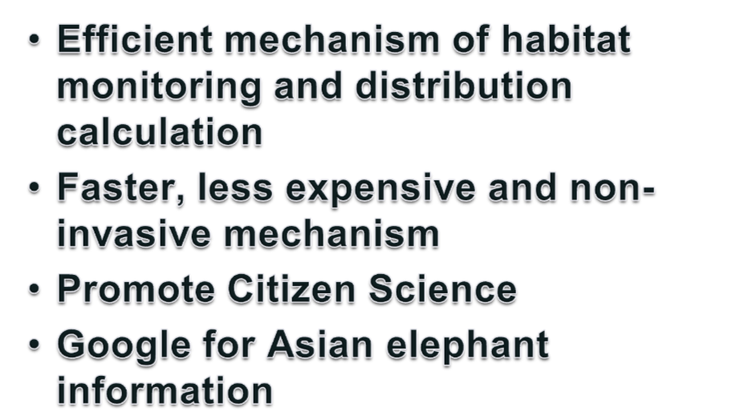
Notes:
*For the conservation and management of elephants, having an efficient mechanism of habitat monitoring and distribution calculation is important.
*Most of such existing mechanisms are expensive while some are invasive methods, which adversely affect the natural life style of elephants. Our approach is to come up with a non-invasive state-of-the-art computer vision based mechanism to identify and track individual elephants.
* People all around the world can actively participate via a web portal. (Google for people)

Slide 3








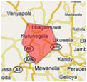
Automated Elephant Recognition System
Notes:
User upload elephant image via elePortal (along with data)
The identification is done by eleID
The results will be given back to the user via elePortal

Slide 4









Methodology
Online Platform
Processing and Analyzing
Elephant Images
Update last observed location and time.
Identifying the elephant using extracted features
Have already identified
New Identification
Give a new identity - eleID

Slide 5


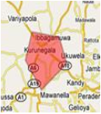


Interface for the users all around the world.
Easy access to individual elephant information.
Promote Citizen Science.
Notes:
*Interface for the user all around the world to upload images and data - According to user category
*Easy access to individual elephant information such as home range information - Researches and registered users can access and get information on individual elephants such as their home range information, unique features, observed dates and locations etc... .
*Promote Citizen Science - Allow a large community work together for elephant management and conservation

Slide 6


Automatically identify individual elephants from given images and data
Initial implementation based on Principal Component Analysis
Need frontal images
Further developments are in progress to make the system robust
Notes:
(To Chandeep: the first sentence is an abstract, the description follows after that)
PCA : used to transform a number of possibly correlated variables into a smaller number of uncorrelated variables called principal components.
That is like finding the fundamental elephant face images (which will look like Ghost images of elephants) which are principle components called as eigenfaces.
Once the eigenfaces are known all other face images can be described using a unique combination of proportions from each “Ghostly face”. That proportions or more precisely the weights are unique for a particular face so that it could use for identification of faces too.
(But we will go beyond this)

Slide 7








eleID cont…
Prior to the identification already identified elephant images should be given to the system
Along with images other information are kept in the database
Notes:
*Prior to the identification already identified elephant images should be given to the system – for training
Other information are;
Last observed location and time
Tail features.
Length of the tail
Nature of the tail tuft
Ears.
Primary and secondary folds.
Ear bottom appearance using contour of an elephant ear.
Rips, holes and notches.
Facial features.

Slide 8






eleID cont…
Eigenfaces of elephant face images
New images given for identification are projected on to the facespace

Slide 9

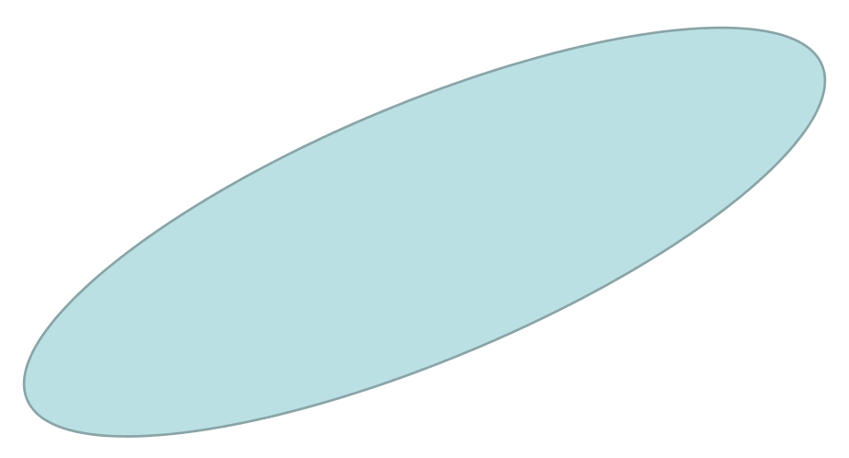



A simple model…
New Image
ID_1
ID_4
Facespace
Project
ID_5
ID_?
ID_3
ID_6
ID_2
Notes:
We project the new image into the facespace
In this example, considering the distance between projected image and ID_3, we can say the relationship between the elephant in the newly given image and ID_3 is very high implying those could be the same elephant.

Slide 10

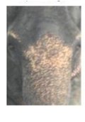
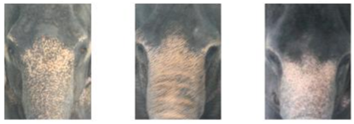
eleID cont…
Best match for the input image will be given.
Other matches are used to verify the result
Input image
Best match
Second match
Third match
Notes:
*Best match for the input image will be given.
- Which is selected from the already identified images
Others matches are used to verify the result

Slide 11
Brick-walls
When pose of the elephant face changes, it affects the accuracy of identification
Have to utilize other information effectively in the identification mechanism
When illumination varies a lot, it affects the accuracy.
Notes:
(second point) – Other information would be;
Tail features.
Length of the tail
Nature of the tail tuft
Ears.
Primary and secondary folds.
Ear bottom appearance using contour of an elephant ear.
Rips, holes and notches.
Facial features
(third point) Illumination – Intra-class difference will be much higher than the inter-class difference under varying illumination conditions, i.e. two images of same the same elephant under varying illumination may look more different than two images of different elephants under uniform illumination (For this to handle we can user the idea of fisherfaces but as I mentioned then we need more than one image per elephant under different illumination conditions)
This can be handle up to some extent if we are focusing more on shapes.

Slide 12
Current work
To handle pose variations in elephant face images, presently AAM - Active Appearance Models are being tested .
Notes:
AAM – Uses both texture and shape for the identification process.
Initially in eigenfaces it only considers the textural information.
ASM (Active Shape Models) – this only considers the shapes.
AAM (Active Appearance Models) considers both shape and texture.
* Here we have to give the position of shapes in the images along with the user interaction.

Slide 13
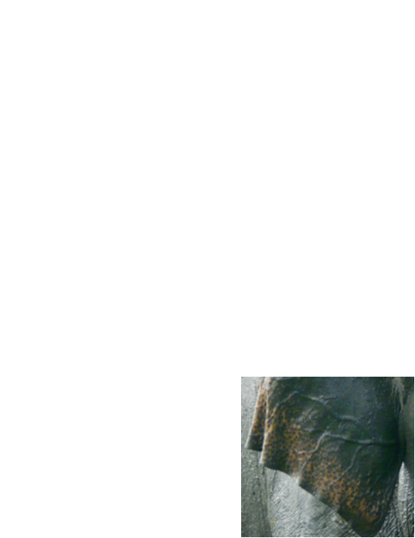
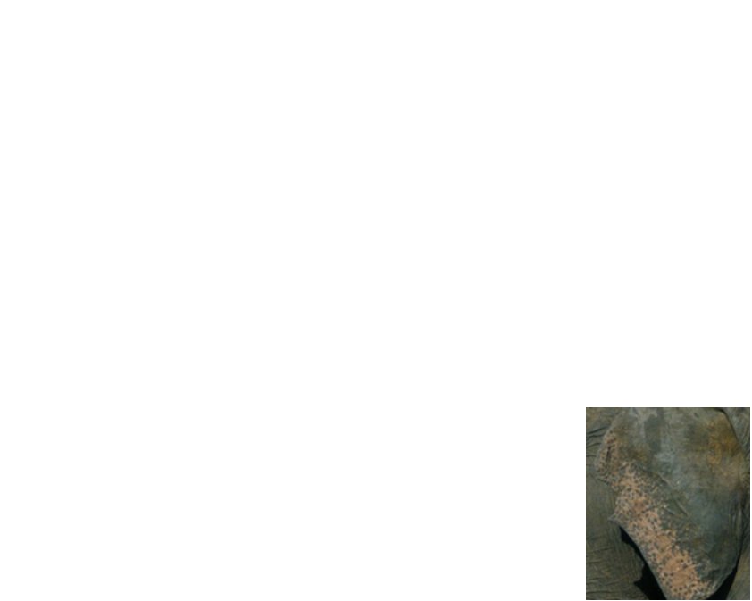

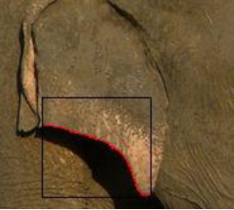
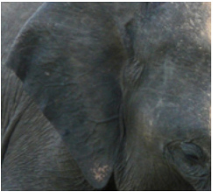
Future direction
Utilize additional information actively in the identification mechanism
Evidence Combining Mechanism.
Eg. Ear data
Notes:
Here the additional information like;
Tail features.
Length of the tail
Nature of the tail tuft
Ears.
Primary and secondary folds.
Ear bottom appearance using contour of an elephant ear.
Rips, holes and notches.
Facial features.
Will also be actively consider in identification process.
(But this will be analyzed based on the results of current research direction)

Slide 14
Summary
Individual elephant identification is important for habitat monitoring.
Computer Vision based mechanisms can be successfully utilized for individual elephant identification.
elePortal enables large community involvement and efficient data handling.
Notes:
Special features : features with minimum intra-individual distance and maximum inter-individual distance.

Slide 15
Acknowledgement
Partially-funded by Tides Foundation through Google Geo Challenge Grant.
Sub-project of Sri Lanka Wildlife Conservation Society’s Saving Elephants by Helping People Project.
Notes:
The eleID© project is partially-funded by the Tides Foundation through Google Geo Challenge Grants and is a sub-project of the Sri Lanka Wildlife Conservation Society's (SLWCS) award winning Saving Elephants by Helping People (SEHP) Project.

Slide 16
Q & A

Slide 17
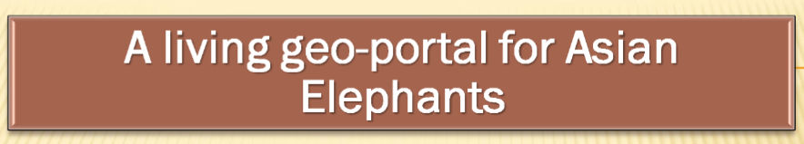
Starting point -> www.AsianElephant.info
Google Earth Maps will be available in the home page
Users can interact with them

Slide 18
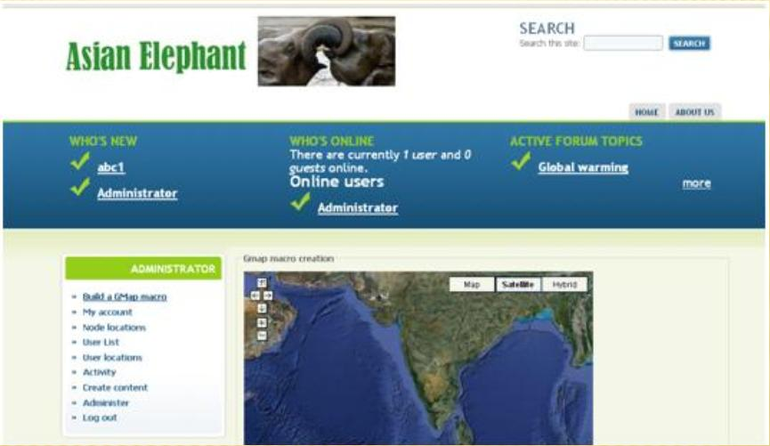

The site will start with a map of Asia and zoom into the area of interest

Slide 19
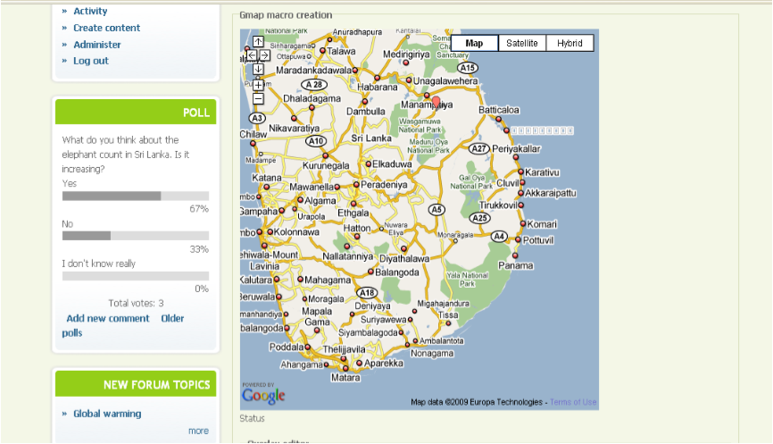
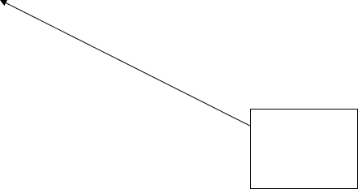
Users can zoom to the level needed

Slide 20

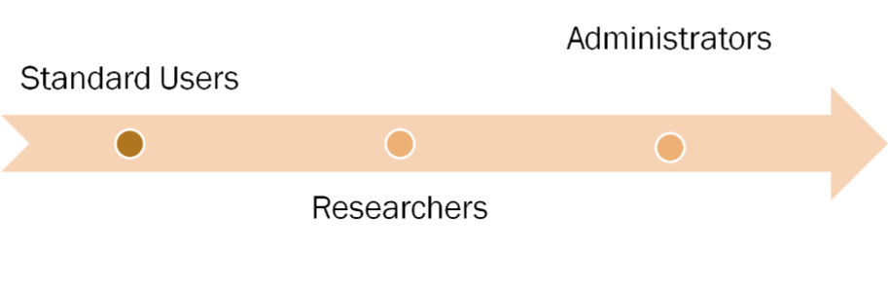
Different types of users have different accessibility levels.

Slide 21
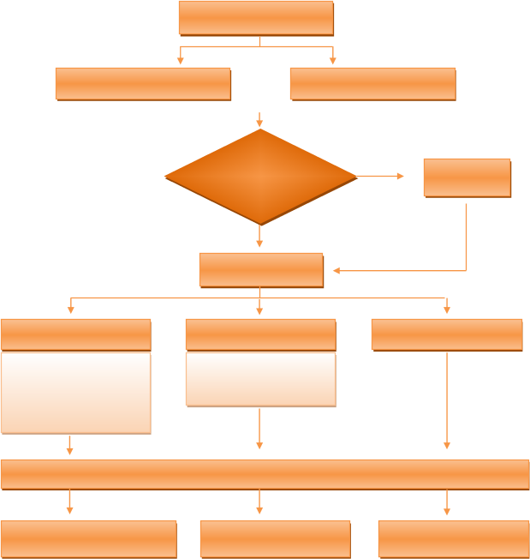
Users
Click on GE image
View a page
Is registered?
No
Register
Yes
Log in
Administrator
Researcher
Standard users
Accepting registration of researchers
Edit and update information
User profile
Upload videos
Search engine
Forums

Slide 22
First, all the users should log in with unique username/password
Without logging in to the system they are not allowed to see the relevant data regarding researches, forums, etc.

Slide 23
The first time users can register for free.
Standard users are being registered by an automated system, while for Researchers, access is granted only after a review of credentials by project staff (Administrators).

Slide 24

Standard users
CAN …….
create their own profiles and update them.
upload videos and images onto the Geo Portal.
share their experiences visually with the forum.
search the database for information.
create a shopping cart to add relevant information that can be accessed at any time for later use.

Slide 25

Researchers
CAN …….
perform all the events which the ‘Regular users’ can perform
draw a polygon covering project areas and then enter information about the data they have for the area and contact information.
directly import Meta data from shape files imported through a semi-automated process.
modify or update existing data.
check stats of who has requested their data.

Slide 26
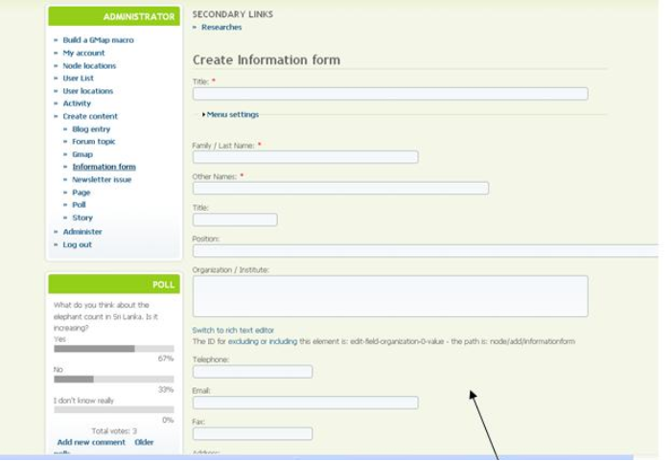

Information of users can be collected through forms and searched by others. Users will also be able to update their profiles, add CV’s etc and reply to Job postings

Slide 27
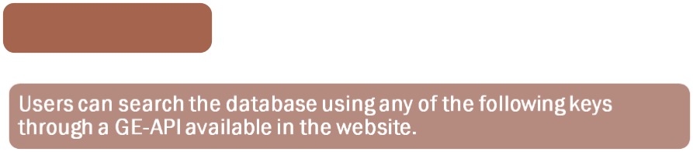
Search Engine
By entering coordinates (WGS84) or a specific location name
By manipulating GE and clicking on an area
By using a drop down list up to divisional level in range areas
By uploading a .kml or .shp file in WGS84 projection
By typing search keywords to generate a map if the requested information exists

Slide 28
For example if we take the above map of Sri Lanka ;
When a user draws a polygon on the map
- It will list the research information of that area.
(Date / Organization / Project Name)

Slide 29
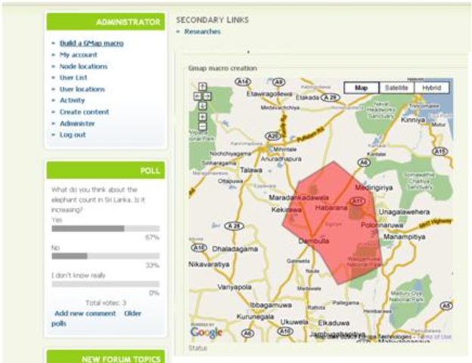


Users can create polygons around areas they are interested in and Researchers can do the same and enter data/published info about their work in the area.
Polls can be conducted on important current issues

Slide 30
Also…..
When someone searches for people working on electric fencing
- The map will come up to show all locations where this work is reported.
- People can click through to get details and download project reports etc

Slide 31
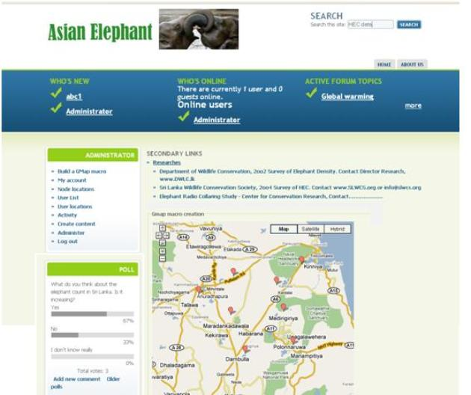

A search then indentifies the locations and existing data sources for the area of interest along with contact info and researchers can edit their own information.

Slide 32


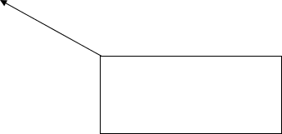
Clients/Users can post and discuss anything about Asian Elephants and get answers by Experts volunteering with AsianElephant.info
Clients/Users can subscribe to a newsletter

Slide 33
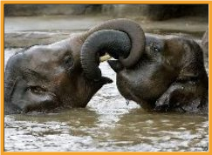
Elephant identification software will also be interfaced with Google Earth through the Geo portal.
This will be a “one stop shop” dynamic Geo Portal for all information pertaining to Asian elephant conservation and research.

Slide 34
Back Up

Slide 35
Unique Features
Tail features.
Length of the tail
Nature of the tail tuft
Ears.
Primary and secondary folds.
Ear bottom appearance using contour of an elephant ear.
Rips, holes and notches.
Facial features.
Notes:
Length of the tail - length of the tail in relation to the back legs of the elephant.
Ear bottom appearance – Curved in, straight line or waves.
Rips, holes and notches – Very useful in unique identification of elephants manually.
Facial features - the distances between eyes and tusks, wrinkles in the upper trunk

Slide 36
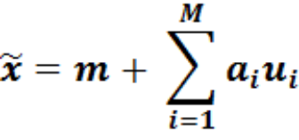





Mathematics behind Eigenfaces
Arbitrary image can be compressed using;
Compressed Image
Eigenfaces
Mean Image
Coefficients unique to the image
Notes:
Eigenfaces have to be find in the traning phase giving already identified images of the elephants to the system.
These Eigenfaces can be considered as the ‘Principal Components’ of elephant face space.

Slide 37

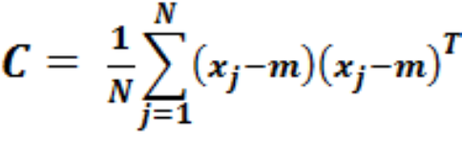





Finding Eigenfaces
Have to analyze the scatter matrix C,
Identified Images
Number of training examples
Mean Image
Cont…
Notes:
Higher the number of good quality examples N, better the results.

Slide 38
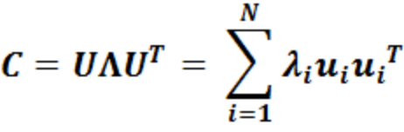




Finding Eigenfaces cont…
Apply Eigenvalue decomposition;
Eigenvectors called as ‘Eigenfaces’
Scatter matrix
Eigenvalues

Slide 39





Identification
Finding the coefficients unique to the frontal image of the elephant;
Elephant image of interest
Unique coefficients
Eigenfaces
Mean Image
Notes:
By projecting the newly given elephant image to the facespace, we can find eigenface weights which are unique to that image.
By measuring the distances of the weights (or coefficients) with already identified elephant images, we can say that ‘the elephant is already identified’ (in the case of small distance) along with the result or ‘this is a new elephant’ .

